Slide 1


Standards of Risk Evidence Driven Behavior-Disease Model
Chenangnon Tovissode
IMCI Postdoc,
ctovissode@uidaho.edu
Prof Bert O. Baumgaertner
Department of Politics and Philosophy,
bbaum@uidaho.edu
March 17, 2023

Slide 2
Revisiting the specification of the prophylactic proportion function

Slide 3

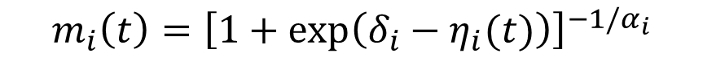
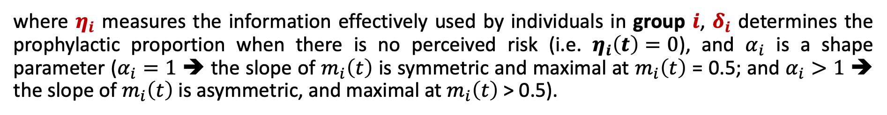
Definition of m_{i}
A Richards growth curve in terms of an information aggregate $η_{i}:$
$$m_{i}\left(t\right)={\left[1+\exp\left(δ_{i}−η_{i}(t)\right)\right]}^{−1/α_{i}}$$
where $η_{i}$ measures the information effectively used by individuals in group $i$, $δ_{i}$ determines the prophylactic proportion when there is no perceived risk (i.e. $η_{i}\left(t\right)=0$), and $α_{i}$ is a shape parameter ($α_{i}=1$ ➔ the slope of $m_{i}\left(t\right)$ is symmetric and maximal at $m_{i}\left(t\right)$ = 0.5; and $α_{i}>1$ ➔ the slope of $m_{i}\left(t\right)$ is asymmetric, and maximal at $m_{i}\left(t\right)$ > 0.5).

Slide 4

Definition of m_{i}
A Richards growth curve in terms of an information aggregate $η_{i}:$
$$m_{i}\left(t\right)={\left[1+\exp\left(δ_{i}−η_{i}(t)\right)\right]}^{−1/α_{i}}$$
The information aggregate $η_{i}$ is defined at time $t$as a quadratic function of the perceived disease prevalence $P\left(t\right)$ and the relative change $Q\left(t\right)$in the number $C\left(t\right)$ of new confirmed positive cases:
$$η_{i}\left(t\right)=a_{pi}P\left(t\right)+u_{pi}{\left[P\left(t\right)\right]}^{2}+v_{i}P\left(t\right)Q\left(t\right)+u_{qi}{\left[Q\left(t\right)\right]}^{2}+a_{qi}Q\left(t\right)$$
where $a_{pi}$, $a_{qi}$, $u_{pi}$, $u_{qi}$, and $v_{i}$ are non-negative real coefficients expressing the weights of linear, quadratic and interaction components of $P\left(t\right)$ and $Q\left(t\right)$ in $η_{i}$.

Slide 5
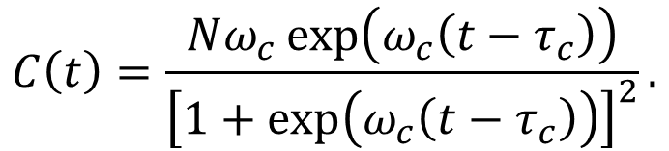
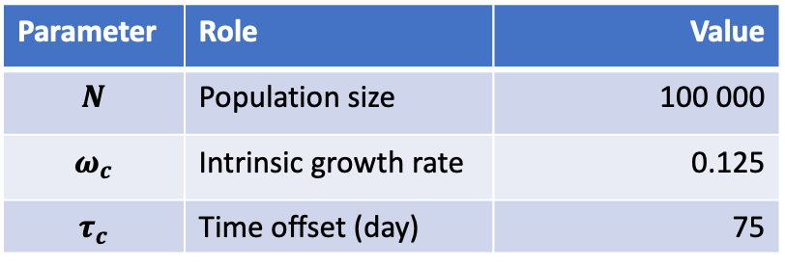
Visualisation of m_{i}
The basic pieces of information - perceived prevalence $P\left(t\right)$ and relative change $Q\left(t\right)$ in $C\left(t\right):$
Logistic number $C\left(t\right)$ of new confirmed positive cases:
$$C\left(t\right)=\frac{Nω_{c}\exp\left(ω_{c}\left(t−τ_{c}\right)\right)}{{\left[1+\exp\left(ω_{c}\left(t−τ_{c}\right)\right)\right]}^{2}}.$$
Parameter | Role | Value
$$N$$ | Population size | 100 000
$$ω_{c}$$ | Intrinsic growth rate | 0.125
$$τ_{c}$$ | Time offset (day) | 75

Slide 6
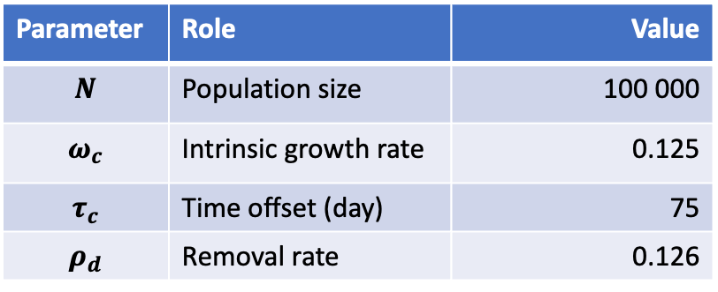
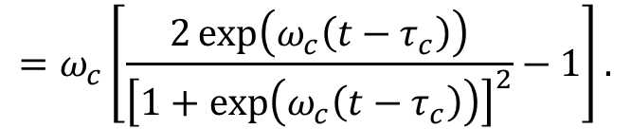
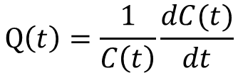
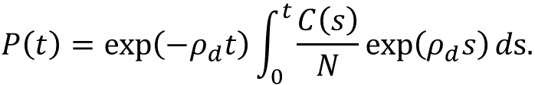
Visualisation of m_{i}
The basic pieces of information - perceived prevalence $P\left(t\right)$ and relative change $Q\left(t\right)$ in $C\left(t\right):$
$$P\left(t\right)=\exp\left(−ρ_{d}t\right)\int_{0}^{t}{\frac{C\left(s\right)}{N}\exp\left(ρ_{d}s\right)}ds.$$
$$Q\left(t\right)=\frac{1}{C\left(t\right)}\frac{dC(t)}{dt}$$
$$=ω_{c}\left[\frac{2\exp\left(ω_{c}\left(t−τ_{c}\right)\right)}{{\left[1+\exp\left(ω_{c}\left(t−τ_{c}\right)\right)\right]}^{2}}−1\right].$$
Parameter | Role | Value
$$N$$ | Population size | 100 000
$$ω_{c}$$ | Intrinsic growth rate | 0.125
$$τ_{c}$$ | Time offset (day) | 75
$$ρ_{d}$$ | Removal rate | 0.126

Slide 7
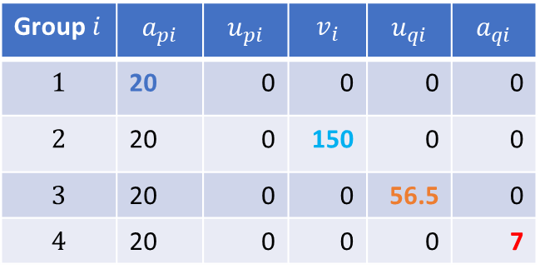
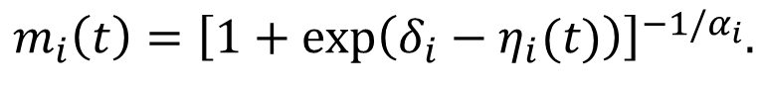
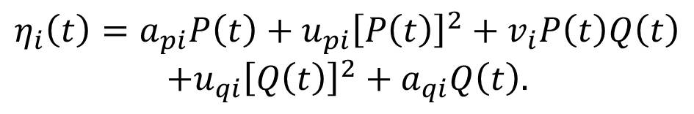
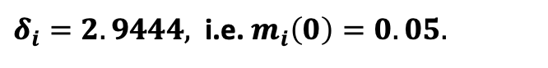
Visualisation of m_{i}
$$m_{i}\left(t\right)={\left[1+\exp\left(δ_{i}−η_{i}(t)\right)\right]}^{−1/α_{i}}.$$
$δ_{i}=2.9444,$ i.e. $m_{i}\left(0\right)=0.05.$
$$η_{i}\left(t\right)=a_{pi}P\left(t\right)+u_{pi}{\left[P\left(t\right)\right]}^{2}+v_{i}P\left(t\right)Q\left(t\right)$$
$$+u_{qi}{\left[Q\left(t\right)\right]}^{2}+a_{qi}Q\left(t\right).$$
Group $i$ | $$a_{pi}$$ | $$u_{pi}$$ | $$v_{i}$$ | $$u_{qi}$$ | $$a_{qi}$$
$$1$$ | 20 | 0 | 0 | 0 | 0
$$2$$ | 20 | 0 | 150 | 0 | 0
$$3$$ | 20 | 0 | 0 | 56.5 | 0
$$4$$ | 20 | 0 | 0 | 0 | 7

Slide 8
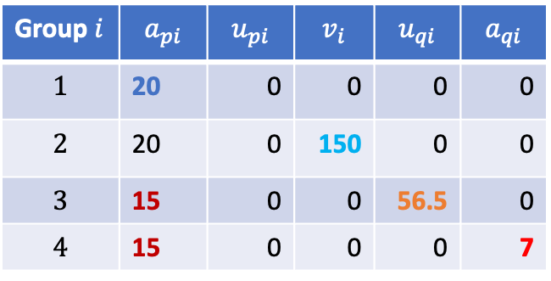

Visualisation of m_{i}
$$m_{i}\left(t\right)={\left[1+\exp\left(δ_{i}−η_{i}(t)\right)\right]}^{−1/α_{i}}.$$
$δ_{i}=2.9444,$ i.e. $m_{i}\left(0\right)=0.05.$
$$η_{i}\left(t\right)=a_{pi}P\left(t\right)+u_{pi}{\left[P\left(t\right)\right]}^{2}+v_{i}P\left(t\right)Q\left(t\right)$$
$$+u_{qi}{\left[Q\left(t\right)\right]}^{2}+a_{qi}Q\left(t\right).$$
Lowering ${ a}_{pi}$
Group $i$ | $$a_{pi}$$ | $$u_{pi}$$ | $$v_{i}$$ | $$u_{qi}$$ | $$a_{qi}$$
$$1$$ | 20 | 0 | 0 | 0 | 0
$$2$$ | 20 | 0 | 150 | 0 | 0
$$3$$ | 15 | 0 | 0 | 56.5 | 0
$$4$$ | 15 | 0 | 0 | 0 | 7

Slide 9
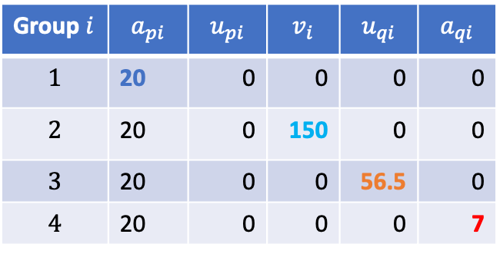

Visualisation of m_{i}
$$m_{i}\left(t\right)={\left[1+\exp\left(δ_{i}−η_{i}(t)\right)\right]}^{−1/α_{i}}.$$
$δ_{i}=2.9444,$ i.e. $m_{i}\left(0\right)=0.05.$
$$η_{i}\left(t\right)=a_{pi}P\left(t\right)+u_{pi}{\left[P\left(t\right)\right]}^{2}+v_{i}P\left(t\right)Q\left(t\right)$$
$$+u_{qi}{\left[Q\left(t\right)\right]}^{2}+a_{qi}Q\left(t\right).$$
Back to ${ a}_{pi}=20$
Group $i$ | $$a_{pi}$$ | $$u_{pi}$$ | $$v_{i}$$ | $$u_{qi}$$ | $$a_{qi}$$
$$1$$ | 20 | 0 | 0 | 0 | 0
$$2$$ | 20 | 0 | 150 | 0 | 0
$$3$$ | 20 | 0 | 0 | 56.5 | 0
$$4$$ | 20 | 0 | 0 | 0 | 7

Slide 10
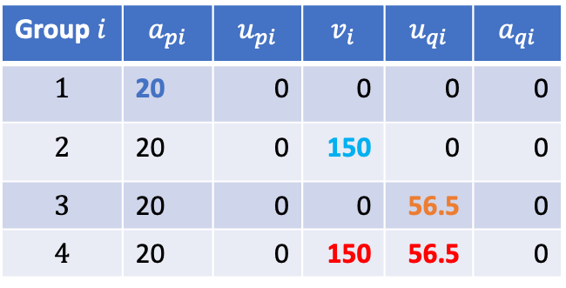
Visualisation of m_{i}
$$m_{i}\left(t\right)={\left[1+\exp\left(δ_{i}−η_{i}(t)\right)\right]}^{−1/α_{i}}.$$
$δ_{i}=2.9444,$ i.e. $m_{i}\left(0\right)=0.05.$
$$η_{i}\left(t\right)=a_{pi}P\left(t\right)+u_{pi}{\left[P\left(t\right)\right]}^{2}+v_{i}P\left(t\right)Q\left(t\right)$$
$$+u_{qi}{\left[Q\left(t\right)\right]}^{2}+a_{qi}Q\left(t\right).$$
Positive of ${ v}_{i}$ and ${ u}_{qi}$ ($i=4$ combines $i=2,3$)
Group $i$ | $$a_{pi}$$ | $$u_{pi}$$ | $$v_{i}$$ | $$u_{qi}$$ | $$a_{qi}$$
$$1$$ | 20 | 0 | 0 | 0 | 0
$$2$$ | 20 | 0 | 150 | 0 | 0
$$3$$ | 20 | 0 | 0 | 56.5 | 0
$$4$$ | 20 | 0 | 150 | 56.5 | 0

Slide 11
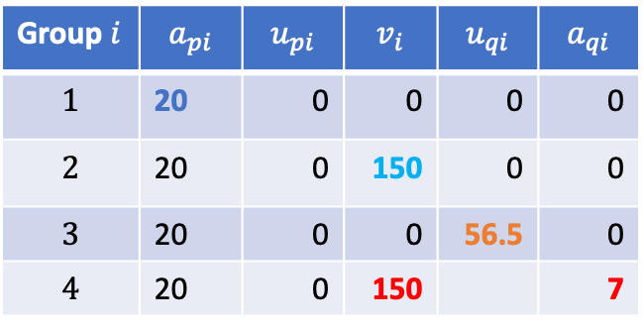
Visualisation of m_{i}
$$m_{i}\left(t\right)={\left[1+\exp\left(δ_{i}−η_{i}(t)\right)\right]}^{−1/α_{i}}.$$
$δ_{i}=2.9444,$ i.e. $m_{i}\left(0\right)=0.05.$
$$η_{i}\left(t\right)=a_{pi}P\left(t\right)+u_{pi}{\left[P\left(t\right)\right]}^{2}+v_{i}P\left(t\right)Q\left(t\right)$$
$$+u_{qi}{\left[Q\left(t\right)\right]}^{2}+a_{qi}Q\left(t\right).$$
Positive of ${ v}_{i}$ and ${ a}_{qi}$ ($i=4$ comb. $i=2,old 4$)
Group $i$ | $$a_{pi}$$ | $$u_{pi}$$ | $$v_{i}$$ | $$u_{qi}$$ | $$a_{qi}$$
$$1$$ | 20 | 0 | 0 | 0 | 0
$$2$$ | 20 | 0 | 150 | 0 | 0
$$3$$ | 20 | 0 | 0 | 56.5 | 0
$$4$$ | 20 | 0 | 150 |  | 7

Slide 12
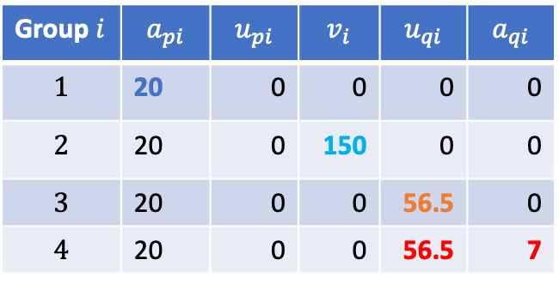
Visualisation of m_{i}
$$m_{i}\left(t\right)={\left[1+\exp\left(δ_{i}−η_{i}(t)\right)\right]}^{−1/α_{i}}.$$
$δ_{i}=2.9444,$ i.e. $m_{i}\left(0\right)=0.05.$
$$η_{i}\left(t\right)=a_{pi}P\left(t\right)+u_{pi}{\left[P\left(t\right)\right]}^{2}+v_{i}P\left(t\right)Q\left(t\right)$$
$$+u_{qi}{\left[Q\left(t\right)\right]}^{2}+a_{qi}Q\left(t\right).$$
Positive of ${ u}_{qi}$ and ${ a}_{qi}$ ($i=4$ comb. $i=3,old 4$)
Group $i$ | $$a_{pi}$$ | $$u_{pi}$$ | $$v_{i}$$ | $$u_{qi}$$ | $$a_{qi}$$
$$1$$ | 20 | 0 | 0 | 0 | 0
$$2$$ | 20 | 0 | 150 | 0 | 0
$$3$$ | 20 | 0 | 0 | 56.5 | 0
$$4$$ | 20 | 0 | 0 | 56.5 | 7

Slide 13
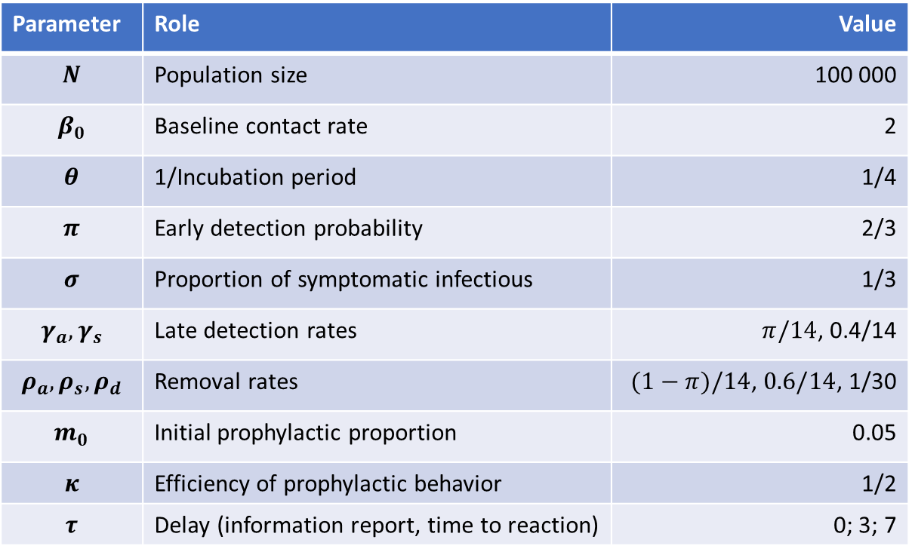
Disease Dynamic Parameters
Parameter | Role | Value
$$N$$ | Population size | 100 000
$$β_{0}$$ | Baseline contact rate | 2
$$θ$$ | 1/Incubation period | 1/4
$$π$$ | Early detection probability | 2/3
$$σ$$ | Proportion of symptomatic infectious | 1/3
$$γ_{a},γ_{s}$$ | Late detection rates | $π/14$, 0.4/14
$$ρ_{a},ρ_{s},ρ_{d}$$ | Removal rates | $(1−π)/14$, $0.6/14$, 1/30
$$m_{0}$$ | Initial prophylactic proportion | 0.05
$$κ$$ | Efficiency of prophylactic behavior | 1/2
$$τ$$ | Delay (information report, time to reaction) | 0; 3; 7

Slide 14

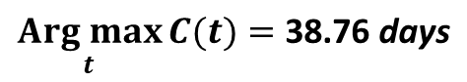
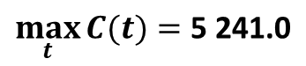


Disease-only Dynamic
Replace by the daily new exposed (derivative of S)
SEIR solution
New positive cases
$$S_{∞}=\text{0}$$
$$\underset{t}{Arg max}{C(t)}=\text{38.76} \text{days}$$
$$\max_{t}{C(t)}=\text{5} \text{241.0}$$
$$\underset{t}{Arg max}{E(t)}=\text{3}\text{8}\text{.51} \text{days}$$
$$\max_{t}{E(t)}=\text{2}\text{8 319}$$

Slide 15
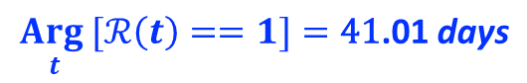
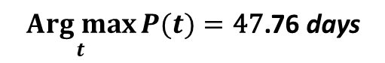
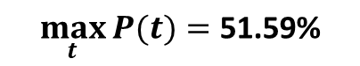
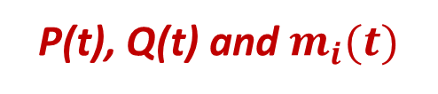
Disease-only Dynamic
Reproductive number
P(t), Q(t) and $m_{i}(t)$
$$\underset{t}{Arg max}{P(t)}=\text{47}\text{.}\text{7}\text{6} \text{days}$$
$$\underset{t}{Arg}{[ℛ\left(t\right)==1]}=\text{41}\text{.}\text{01} \text{days}$$
$$\max_{t}{P(t)}=\text{51.59\%}$$

Slide 16
Joint Disease-Prophylactic Dynamics
Scenarios A:
- no differential standard of risk
- all individuals pay attention to prevalence only

Slide 17
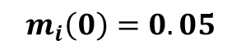
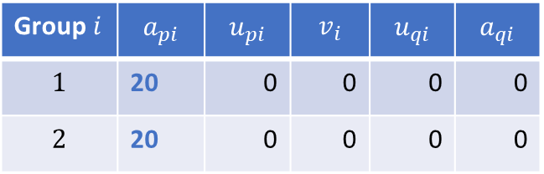
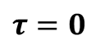
Joint Disease-Prophylactic Dynamics
Scenario A0:
- no differential standard of risk
- all individuals pay attention to prevalence only
Group $i$ | $$a_{pi}$$ | $$u_{pi}$$ | $$v_{i}$$ | $$u_{qi}$$ | $$a_{qi}$$
$$1$$ | 20 | 0 | 0 | 0 | 0
$$2$$ | 20 | 0 | 0 | 0 | 0
$$m_{i}\left(0\right)=0.05$$
$$τ=0$$

Slide 18

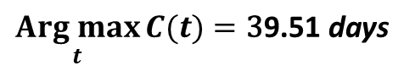
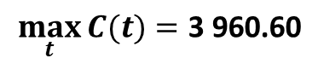

Disease-only Dynamic
SEIR solution
New positive cases
$$S_{∞}=\text{0}$$
$$\underset{t}{Arg max}{C(t)}=\text{3}\text{9.5}\text{1} \text{days}$$
$$\max_{t}{C(t)}=\text{3} \text{960}\text{.60}$$
$$\underset{t}{Arg max}{E(t)}=\text{3}\text{8}\text{.76} \text{days}$$
$$\max_{t}{E(t)}=\text{21} \text{053}$$

Slide 19
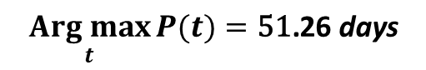
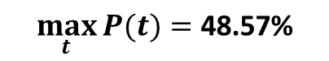
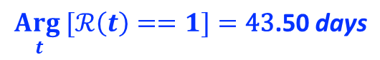
Joint Disease-Behavior Dynamic
Reproductive number
P(t), Q(t) and $m_{i}(t)$
$$\underset{t}{Arg max}{P(t)}=\text{51}\text{.26} \text{days}$$
$$\underset{t}{Arg}{[ℛ\left(t\right)==1]}=\text{43}\text{.5}\text{0} \text{days}$$
$$\max_{t}{P(t)}=\text{48.57\%}$$

Slide 20

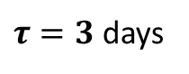
Joint Disease-Prophylactic Dynamics
Scenario A1:
- no differential standard of risk
- all individuals pay attention to prevalence only
Group $i$ | $$a_{pi}$$ | $$u_{pi}$$ | $$v_{i}$$ | $$u_{qi}$$ | $$a_{qi}$$
$$1$$ | 20 | 0 | 0 | 0 | 0
$$2$$ | 20 | 0 | 0 | 0 | 0
$$From τ=0 to τ=3 days.$$
$$m_{i}\left(0\right)=0.05$$
$τ=3$ days

Slide 21

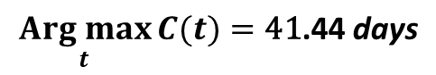
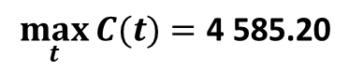

Disease-only Dynamic
SEIR solution
New positive cases
$$S_{∞}=\text{0}$$
$$\underset{t}{Arg max}{C(t)}=\text{41}\text{.44} \text{days}$$
$$\max_{t}{C(t)}=\text{4 585.20}$$
$$\underset{t}{Arg max}{E(t)}=\text{3}\text{7}\text{.}\text{95} \text{days}$$
$$\max_{t}{E(t)}=\text{2}\text{4 765}$$

Slide 22

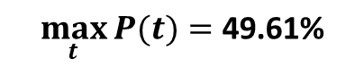
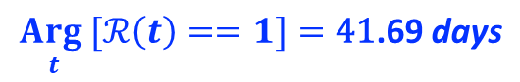
Joint Disease-Behavior Dynamic
Reproductive number
P(t), Q(t) and $m_{i}(t)$
$$\underset{t}{Arg max}{P(t)}=\text{52}\text{.}\text{68} \text{days}$$
$$\underset{t}{Arg}{[ℛ\left(t\right)==1]}=\text{41}\text{.}\text{69} \text{days}$$
$$\max_{t}{P(t)}=\text{49.61\%}$$

Slide 23

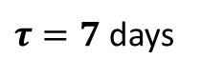
Joint Disease-Prophylactic Dynamics
Scenario A2:
- no differential standard of risk
- all individuals pay attention to prevalence only
Group $i$ | $$a_{pi}$$ | $$u_{pi}$$ | $$v_{i}$$ | $$u_{qi}$$ | $$a_{qi}$$
$$1$$ | 20 | 0 | 0 | 0 | 0
$$2$$ | 20 | 0 | 0 | 0 | 0
$$From τ=3 to τ=7 days.$$
$$m_{i}\left(0\right)=0.05$$
$τ=7$ days

Slide 24

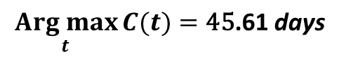
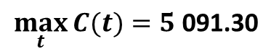

Disease-only Dynamic
SEIR solution
New positive cases
$$S_{∞}=\text{0}$$
$$\underset{t}{Arg max}{C(t)}=\text{45}\text{.}\text{61} \text{days}$$
$$\max_{t}{C(t)}=5\text{ 091.30}$$
$$\underset{t}{Arg max}{E(t)}=\text{3}\text{8}\text{.}\text{39} \text{days}$$
$$\max_{t}{E(t)}=\text{2}\text{7 505}$$

Slide 25

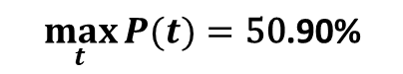
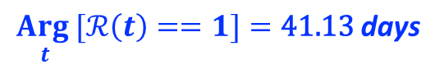
Joint Disease-Behavior Dynamic
Reproductive number
P(t), Q(t) and $m_{i}(t)$
$$\underset{t}{Arg max}{P(t)}=\text{55}\text{.}\text{33} \text{days}$$
$$\underset{t}{Arg}{[ℛ\left(t\right)==1]}=\text{41.13} \text{days}$$
$$\max_{t}{P(t)}=\text{50}\text{.90\%}$$

Slide 26

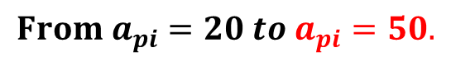
Joint Disease-Prophylactic Dynamics
Scenario A3:
- no differential standard of risk
- all individuals pay attention to prevalence only
$$From a_{pi}=20 to a_{pi}=50.$$
Group $i$ | $$a_{pi}$$ | $$u_{pi}$$ | $$v_{i}$$ | $$u_{qi}$$ | $$a_{qi}$$
$$1$$ | 50 | 0 | 0 | 0 | 0
$$2$$ | 50 | 0 | 0 | 0 | 0
$$m_{i}\left(0\right)=0.05$$
$$τ=0$$

Slide 27

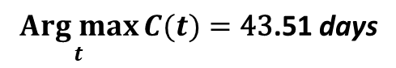
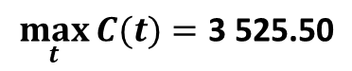

Disease-only Dynamic
SEIR solution
New positive cases
$$S_{∞}=\text{0}$$
$$\underset{t}{Arg max}{C(t)}=\text{43}\text{.5}\text{1} \text{days}$$
$$\max_{t}{C(t)}=\text{3}\text{ 525.50}$$
$$\underset{t}{Arg max}{E(t)}=\text{43}\text{.01} \text{days}$$
$$\max_{t}{E(t)}=\text{18}\text{ 313}$$

Slide 28
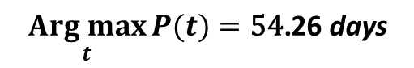
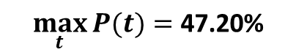
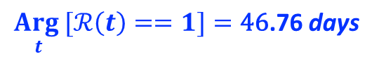
Joint Disease-Behavior Dynamic
Reproductive number
P(t), Q(t) and $m_{i}(t)$
$$\underset{t}{Arg max}{P(t)}=\text{54}\text{.26} \text{days}$$
$$\underset{t}{Arg}{[ℛ\left(t\right)==1]}=\text{46}\text{.}\text{76} \text{days}$$
$$\max_{t}{P(t)}=\text{47.20\%}$$

Slide 29
Joint Disease-Prophylactic Dynamics
Scenarios B:
- no differential standard of risk
- all individuals pay attention to prevalence and its interaction with Q

Slide 30
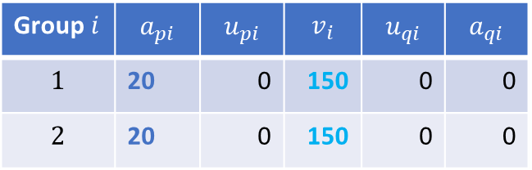
Joint Disease-Prophylactic Dynamics
Scenario B0:
- no differential standard of risk
- all individuals pay attention to prevalence and its interaction with Q
Group $i$ | $$a_{pi}$$ | $$u_{pi}$$ | $$v_{i}$$ | $$u_{qi}$$ | $$a_{qi}$$
$$1$$ | 20 | 0 | 150 | 0 | 0
$$2$$ | 20 | 0 | 150 | 0 | 0
$$m_{i}\left(0\right)=0.05$$
$$τ=0$$

Slide 31

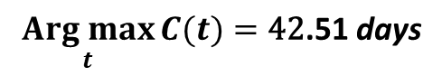


Disease-only Dynamic
SEIR solution
New positive cases
$$S_{∞}=\text{0}$$
$$\underset{t}{Arg max}{C(t)}=\text{42}\text{.}\text{51} \text{days}$$
$$\max_{t}{C(t)}=\text{3}\text{ 656.30}$$
$$\underset{t}{Arg max}{E(t)}=\text{41}\text{.}\text{76} \text{days}$$
$$\max_{t}{E(t)}=\text{19}\text{ 070}$$

Slide 32



Joint Disease-Behavior Dynamic
Reproductive number
P(t), Q(t) and $m_{i}(t)$
$$\underset{t}{Arg max}{P(t)}=\text{53}\text{.}\text{51} \text{days}$$
$$\underset{t}{Arg}{[ℛ\left(t\right)==1]}=\text{46}\text{.}\text{26} \text{days}$$
$$\max_{t}{P(t)}=\text{48.36\%}$$

Slide 33

Joint Disease-Prophylactic Dynamics
Scenario B1:
- no differential standard of risk
- all individuals pay attention to prevalence and its interaction with Q
Group $i$ | $$a_{pi}$$ | $$u_{pi}$$ | $$v_{i}$$ | $$u_{qi}$$ | $$a_{qi}$$
$$1$$ | 20 | 0 | 150 | 0 | 0
$$2$$ | 20 | 0 | 150 | 0 | 0
$$m_{i}\left(0\right)=0.05$$
$τ=3$ days

Slide 34




Disease-only Dynamic
SEIR solution
New positive cases
$$S_{∞}=\text{0}$$
$$\underset{t}{Arg max}{C(t)}=\text{43}\text{.}\text{63} \text{days}$$
$$\max_{t}{C(t)}=\text{3}\text{ 847.50}$$
$$\underset{t}{Arg max}{E(t)}=\text{39}\text{.}\text{94} \text{days}$$
$$\max_{t}{E(t)}=\text{20}\text{ 264}$$

Slide 35



Joint Disease-Behavior Dynamic
Reproductive number
P(t), Q(t) and $m_{i}(t)$
$$\underset{t}{Arg max}{P(t)}=\text{54}\text{.}\text{9}\text{6} \text{days}$$
$$\underset{t}{Arg}{[ℛ\left(t\right)==1]}=\text{44}\text{.}\text{37} \text{days}$$
$$\max_{t}{P(t)}=\text{48.61\%}$$

Slide 36

Joint Disease-Prophylactic Dynamics
Scenario B2:
- no differential standard of risk
- all individuals pay attention to prevalence and its interaction with Q
Group $i$ | $$a_{pi}$$ | $$u_{pi}$$ | $$v_{i}$$ | $$u_{qi}$$ | $$a_{qi}$$
$$1$$ | 20 | 0 | 150 | 0 | 0
$$2$$ | 20 | 0 | 150 | 0 | 0
$$m_{i}\left(0\right)=0.05$$
$τ=7$ days

Slide 37




Disease-only Dynamic
SEIR solution
New positive cases
$$S_{∞}=\text{0}$$
$$\underset{t}{Arg max}{C(t)}=\text{41}\text{.}\text{12} \text{days}$$
$$\max_{t}{C(t)}=\text{4}\text{ 496.20}$$
$$\underset{t}{Arg max}{E(t)}=\text{37}\text{.}\text{89} \text{days}$$
$$\max_{t}{E(t)}=\text{24}\text{ 277}$$

Slide 38



Joint Disease-Behavior Dynamic
Reproductive number
P(t), Q(t) and $m_{i}(t)$
$$\underset{t}{Arg max}{P(t)}=\text{56}\text{.}\text{83} \text{days}$$
$$\underset{t}{Arg}{[ℛ\left(t\right)==1]}=\text{42}\text{.}\text{13} \text{days}$$
$$\max_{t}{P(t)}=\text{49.55\%}$$

Slide 39


Joint Disease-Prophylactic Dynamics
Scenario B3:
- no differential standard of risk
- all individuals pay attention to prevalence and its interaction with Q
Group $i$ | $$a_{pi}$$ | $$u_{pi}$$ | $$v_{i}$$ | $$u_{qi}$$ | $$a_{qi}$$
$$1$$ | 20 | 0 | 300 | 0 | 0
$$2$$ | 20 | 0 | 300 | 0 | 0
$$m_{i}\left(0\right)=0.05$$
$τ=0$ days

Slide 40




Disease-only Dynamic
SEIR solution
New positive cases
$$S_{∞}=\text{0}$$
$$\underset{t}{Arg max}{C(t)}=\text{44}\text{.}\text{26} \text{days}$$
$$\max_{t}{C(t)}=\text{3}\text{ 525.00}$$
$$\underset{t}{Arg max}{E(t)}=\text{43}\text{.}\text{76} \text{days}$$
$$\max_{t}{E(t)}=\text{18}\text{ 298}$$

Slide 41



Joint Disease-Behavior Dynamic
Reproductive number
P(t), Q(t) and $m_{i}(t)$
$$\underset{t}{Arg max}{P(t)}=\text{54}\text{.}\text{51} \text{days}$$
$$\underset{t}{Arg}{[ℛ\left(t\right)==1]}=\text{47}\text{.}\text{01} \text{days}$$
$$\max_{t}{P(t)}=\text{48.42\%}$$

Slide 42

Joint Disease-Prophylactic Dynamics
Scenario B3:
- no differential standard of risk
- all individuals pay attention to prevalence and its interaction with Q
Group $i$ | $$a_{pi}$$ | $$u_{pi}$$ | $$v_{i}$$ | $$u_{qi}$$ | $$a_{qi}$$
$$1$$ | 20 | 0 | 1000 | 0 | 0
$$2$$ | 20 | 0 | 1000 | 0 | 0
$$m_{i}\left(0\right)=0.05$$
$τ=0$ days

Slide 43




Disease-only Dynamic
SEIR solution
New positive cases
$$S_{∞}=\text{0}$$
$$\underset{t}{Arg max}{C(t)}=\text{49}\text{.}\text{51} \text{days}$$
$$\max_{t}{C(t)}=\text{3}\text{ 614.30}$$
$$\underset{t}{Arg max}{E(t)}=\text{49}\text{.}\text{51} \text{days}$$
$$\max_{t}{E(t)}=\text{18}\text{ 545}$$

Slide 44



Joint Disease-Behavior Dynamic
Reproductive number
P(t), Q(t) and $m_{i}(t)$
$$\underset{t}{Arg max}{P(t)}=\text{57}\text{.}\text{51} \text{days}$$
$$\underset{t}{Arg}{[ℛ\left(t\right)==1]}=\text{52}\text{.}\text{01} \text{days}$$
$$\max_{t}{P(t)}=\text{48.18\%}$$

Slide 45
Joint Disease-Prophylactic Dynamics
Scenarios C:
- no differential standard of risk
- all individuals pay attention to prevalence and Q^2

Slide 46

Joint Disease-Prophylactic Dynamics
Scenario C0:
- no differential standard of risk
- all individuals pay attention to prevalence and Q^2
Group $i$ | $$a_{pi}$$ | $$u_{pi}$$ | $$v_{i}$$ | $$u_{qi}$$ | $$a_{qi}$$
$$1$$ | 20 | 0 | 0 | 56.5 | 0
$$2$$ | 20 | 0 | 0 | 56.5 | 0
$$m_{i}\left(0\right)=0.05$$
$$τ=0$$

Slide 47




Disease-only Dynamic
SEIR solution
New positive cases
$$S_{∞}=\text{0}$$
$$\underset{t}{Arg max}{C(t)}=\text{48}\text{.}\text{76} \text{days}$$
$$\max_{t}{C(t)}=\text{3}\text{ 802.10}$$
$$\underset{t}{Arg max}{E(t)}=\text{48}\text{.}\text{01} \text{days}$$
$$\max_{t}{E(t)}=\text{20}\text{ 069}$$

Slide 48



Joint Disease-Behavior Dynamic
Reproductive number
P(t), Q(t) and $m_{i}(t)$
$$\underset{t}{Arg max}{P(t)}=\text{60}\text{.}\text{26} \text{days}$$
$$\underset{t}{Arg}{[ℛ\left(t\right)==1]}=\text{52}\text{.}\text{51} \text{days}$$
$$\max_{t}{P(t)}=\text{47.94\%}$$

Slide 49

Joint Disease-Prophylactic Dynamics
Scenario C1:
- no differential standard of risk
- all individuals pay attention to prevalence and Q^2
Group $i$ | $$a_{pi}$$ | $$u_{pi}$$ | $$v_{i}$$ | $$u_{qi}$$ | $$a_{qi}$$
$$1$$ | 20 | 0 | 0 | 56.5 | 0
$$2$$ | 20 | 0 | 0 | 56.5 | 0
$$m_{i}\left(0\right)=0.05$$
$$τ=3$$

Slide 50




Disease-only Dynamic
SEIR solution
New positive cases
$$S_{∞}=\text{0}$$
$$\underset{t}{Arg max}{C(t)}=\text{49}\text{.}\text{79} \text{days}$$
$$\max_{t}{C(t)}=\text{4}\text{ 073.30}$$
$$\underset{t}{Arg max}{E(t)}=\text{46}\text{.}\text{59} \text{days}$$
$$\max_{t}{E(t)}=\text{21}\text{ 597}$$

Slide 51



Joint Disease-Behavior Dynamic
Reproductive number
P(t), Q(t) and $m_{i}(t)$
$$\underset{t}{Arg max}{P(t)}=\text{60}\text{.87} \text{days}$$
$$\underset{t}{Arg}{[ℛ\left(t\right)==1]}=\text{50}\text{.}\text{28} \text{days}$$
$$\max_{t}{P(t)}=\text{48}\text{.48\%}$$

Slide 52

Joint Disease-Prophylactic Dynamics
Scenario C2:
- no differential standard of risk
- all individuals pay attention to prevalence and Q^2
Group $i$ | $$a_{pi}$$ | $$u_{pi}$$ | $$v_{i}$$ | $$u_{qi}$$ | $$a_{qi}$$
$$1$$ | 20 | 0 | 0 | 56.5 | 0
$$2$$ | 20 | 0 | 0 | 56.5 | 0
$$m_{i}\left(0\right)=0.05$$
$$τ=7$$

Slide 53




Disease-only Dynamic
SEIR solution
New positive cases
$$S_{∞}=\text{0}$$
$$\underset{t}{Arg max}{C(t)}=51\text{.}\text{39} \text{days}$$
$$\max_{t}{C(t)}=\text{4}\text{ 401.90}$$
$$\underset{t}{Arg max}{E(t)}=\text{44}\text{.}\text{15} \text{days}$$
$$\max_{t}{E(t)}=\text{23}\text{ 786}$$

Slide 54



Joint Disease-Behavior Dynamic
Reproductive number
P(t), Q(t) and $m_{i}(t)$
$$\underset{t}{Arg max}{P(t)}=\text{62}\text{.}\text{9}\text{7} \text{days}$$
$$\underset{t}{Arg}{[ℛ\left(t\right)==1]}=\text{48}\text{.}\text{74} \text{days}$$
$$\max_{t}{P(t)}=\text{49}\text{.36\%}$$

Slide 55

Joint Disease-Prophylactic Dynamics
Scenario C3:
- no differential standard of risk
- all individuals pay attention to prevalence and Q^2
Group $i$ | $$a_{pi}$$ | $$u_{pi}$$ | $$v_{i}$$ | $$u_{qi}$$ | $$a_{qi}$$
$$1$$ | 20 | 0 | 0 | 100 | 0
$$2$$ | 20 | 0 | 0 | 100 | 0
$$m_{i}\left(0\right)=0.05$$
$$τ=0$$

Slide 56




Disease-only Dynamic
SEIR solution
New positive cases
$$S_{∞}=\text{0}$$
$$\underset{t}{Arg max}{C(t)}=\text{50}\text{.}\text{26} \text{days}$$
$$\max_{t}{C(t)}=\text{3}\text{ 737.90}$$
$$\underset{t}{Arg max}{E(t)}=\text{49}\text{.}\text{76} \text{days}$$
$$\max_{t}{E(t)}=\text{19}\text{ 663}$$

Slide 57



Joint Disease-Behavior Dynamic
Reproductive number
P(t), Q(t) and $m_{i}(t)$
$$\underset{t}{Arg max}{P(t)}=\text{61}\text{.}\text{51} \text{days}$$
$$\underset{t}{Arg}{[ℛ\left(t\right)==1]}=\text{54}\text{.}\text{01} \text{days}$$
$$\max_{t}{P(t)}=\text{47.71\%}$$

Slide 58
Joint Disease-Prophylactic Dynamics
Scenario C4:
- no differential standard of risk
- all individuals pay attention to prevalence and Q^2
Group $i$ | $$a_{pi}$$ | $$u_{pi}$$ | $$v_{i}$$ | $$u_{qi}$$ | $$a_{qi}$$
$$1$$ | 20 | 0 | 0 | 100 | 0
$$2$$ | 20 | 0 | 0 | 100 | 0
$$m_{i}\left(0\right)=0.05$$
$$τ=7$$

Slide 59




Disease-only Dynamic
SEIR solution
New positive cases
$$S_{∞}=\text{0}$$
$$\underset{t}{Arg max}{C(t)}=\text{55}\text{.}\text{97} \text{days}$$
$$\max_{t}{C(t)}=\text{4}\text{ 193.20}$$
$$\underset{t}{Arg max}{E(t)}=\text{48}\text{.}\text{49} \text{days}$$
$$\max_{t}{E(t)}=\text{22}\text{ 209}$$

Slide 60



Joint Disease-Behavior Dynamic
Reproductive number
P(t), Q(t) and $m_{i}(t)$
$$\underset{t}{Arg max}{P(t)}=\text{66}\text{.}\text{11} \text{days}$$
$$\underset{t}{Arg}{[ℛ\left(t\right)==1]}=\text{52}\text{.}\text{11} \text{days}$$
$$\max_{t}{P(t)}=\text{48.66\%}$$

Slide 61
Joint Disease-Prophylactic Dynamics
Scenarios D:
- no differential standard of risk
- all individuals pay attention to prevalence and Q

Slide 62

Joint Disease-Prophylactic Dynamics
Scenario D0:
- no differential standard of risk
- all individuals pay attention to prevalence and Q
Group $i$ | $$a_{pi}$$ | $$u_{pi}$$ | $$v_{i}$$ | $$u_{qi}$$ | $$a_{qi}$$
$$1$$ | 20 | 0 | 0 | 0 | 7
$$2$$ | 20 | 0 | 0 | 0 | 7
$$m_{i}\left(0\right)=0.05$$
$$τ=0$$

Slide 63


Disease-only Dynamic
SEIR solution
New positive cases
$$S_{∞}=\text{0}$$
$$\underset{t}{Arg max}{C(t)}=\text{43}\text{.}\text{51} \text{days}$$
$$\max_{t}{C(t)}=\text{3}\text{ 817.40}$$
$$\underset{t}{Arg max}{E(t)}=\text{43}\text{.}\text{01} \text{days}$$
$$\max_{t}{E(t)}=\text{20}\text{ 119}$$

Slide 64



Joint Disease-Behavior Dynamic
Reproductive number
P(t), Q(t) and $m_{i}(t)$
$$\underset{t}{Arg max}{P(t)}=\text{55}\text{.}\text{01} \text{days}$$
$$\underset{t}{Arg}{[ℛ\left(t\right)==1]}=\text{47}\text{.}\text{26} \text{days}$$
$$\max_{t}{P(t)}=\text{48.12\%}$$

Slide 65
Joint Disease-Prophylactic Dynamics
Scenario D1:
- no differential standard of risk
- all individuals pay attention to prevalence and Q
Group $i$ | $$a_{pi}$$ | $$u_{pi}$$ | $$v_{i}$$ | $$u_{qi}$$ | $$a_{qi}$$
$$1$$ | 20 | 0 | 0 | 0 | 7
$$2$$ | 20 | 0 | 0 | 0 | 7
$$m_{i}\left(0\right)=0.05$$
$$τ=7$$

Slide 66




Disease-only Dynamic
SEIR solution
New positive cases
$$S_{∞}=\text{0}$$
$$\underset{t}{Arg max}{C(t)}=\text{48}\text{.}\text{50} \text{days}$$
$$\max_{t}{C(t)}=\text{4}\text{ 627.40}$$
$$\underset{t}{Arg max}{E(t)}=\text{41}\text{.}\text{02} \text{days}$$
$$\max_{t}{E(t)}=\text{24}\text{ 824}$$

Slide 67



Joint Disease-Behavior Dynamic
Reproductive number
P(t), Q(t) and $m_{i}(t)$
$$\underset{t}{Arg max}{P(t)}=\text{58}\text{.}\text{63} \text{days}$$
$$\underset{t}{Arg}{[ℛ\left(t\right)==1]}=\text{44}\text{.}\text{39} \text{days}$$
$$\max_{t}{P(t)}=\text{49.92\%}$$

Slide 68

Joint Disease-Prophylactic Dynamics
Scenario D2:
- no differential standard of risk
- all individuals pay attention to prevalence and Q
Group $i$ | $$a_{pi}$$ | $$u_{pi}$$ | $$v_{i}$$ | $$u_{qi}$$ | $$a_{qi}$$
$$1$$ | 20 | 0 | 0 | 0 | 20
$$2$$ | 20 | 0 | 0 | 0 | 20
$$m_{i}\left(0\right)=0.05$$
$$τ=0$$

Slide 69




Disease-only Dynamic
SEIR solution
New positive cases
$$S_{∞}=\text{0}$$
$$\underset{t}{Arg max}{C(t)}=\text{53}\text{.}\text{76} \text{days}$$
$$\max_{t}{C(t)}=\text{3}\text{ 593.60}$$
$$\underset{t}{Arg max}{E(t)}=\text{53}\text{.}\text{01} \text{days}$$
$$\max_{t}{E(t)}=\text{18}\text{ 764}$$

Slide 70



Joint Disease-Behavior Dynamic
Reproductive number
P(t), Q(t) and $m_{i}(t)$
$$\underset{t}{Arg max}{P(t)}=\text{64}\text{.}\text{51} \text{days}$$
$$\underset{t}{Arg}{[ℛ\left(t\right)==1]}=\text{57}\text{.}\text{26} \text{days}$$
$$\max_{t}{P(t)}=\text{47.24\%}$$

Slide 71
Joint Disease-Prophylactic Dynamics
Scenario D3:
- no differential standard of risk
- all individuals pay attention to prevalence and Q
Group $i$ | $$a_{pi}$$ | $$u_{pi}$$ | $$v_{i}$$ | $$u_{qi}$$ | $$a_{qi}$$
$$1$$ | 20 | 0 | 0 | 0 | 20
$$2$$ | 20 | 0 | 0 | 0 | 20
$$m_{i}\left(0\right)=0.05$$
$$τ=7$$

Slide 72




Disease-only Dynamic
SEIR solution
New positive cases
$$S_{∞}=\text{0}$$
$$\underset{t}{Arg max}{C(t)}=\text{58}\text{.}\text{15} \text{days}$$
$$\max_{t}{C(t)}=\text{3}\text{ 792.00}$$
$$\underset{t}{Arg max}{E(t)}=\text{48}\text{.}\text{98} \text{days}$$
$$\max_{t}{E(t)}=\text{19}\text{ 966}$$

Slide 73



Joint Disease-Behavior Dynamic
Reproductive number
P(t), Q(t) and $m_{i}(t)$
$$\underset{t}{Arg max}{P(t)}=\text{68}\text{.}\text{04} \text{days}$$
$$\underset{t}{Arg}{[ℛ\left(t\right)==1]}=\text{53}\text{.}\text{80} \text{days}$$
$$\max_{t}{P(t)}=\text{47.92\%}$$

Slide 74
Vary initial proportions of S_{-1} and S_{1}

